Slide 1
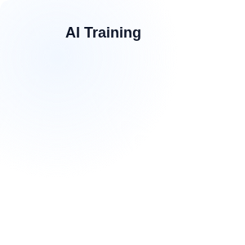




Slide 01
What is LLM Fine-Tuning?
Adapting Foundation Models to Specific Domains
DEFINITION
REAL-LIFE ANALOGY
🩺
Fine-tuning is the process of adjusting the internal weights of a pre-trained Large Language Model (LLM) using task-specific data to permanently improve its performance on specialized tasks or formats.
Think of a medical resident. Pre-training is general medical school. Fine-tuning is their specialized residency in cardiology or neurology to master a specific domain.
Mapping: Fine-tuning gives the model specialized reflexes without forgetting its foundational knowledge.
Weights
Behavior
Adaptation
TRAINING PIPELINE
CODE EXAMPLE
PEFT INITIALIZATION
MODEL EXECUTION
Input
→
Base Model
→
Prep Data
→
Train Weights
→
Output
peft_config = LoraConfig( r=16, lora_alpha=32, target_modules=["q_proj"] ) model = get_peft_model(model)
trainer = Trainer( model=model, train_dataset=dataset, args=TrainingArguments(...) ) trainer.train()
The training pipeline creates a uniquely customized and optimized model file containing the updated parameters.
Fine-tuning changes the model's actual behavior and tone, rather than just giving it temporary prompt context.
The output is a uniquely customized model file.

Slide 2

Slide 02
The Customization Spectrum
Navigating the trade-offs between effort and capability.
There are multiple ways to customize an AI; fine-tuning is only one piece of the puzzle.

Slide 3

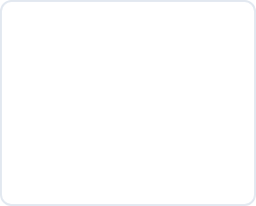
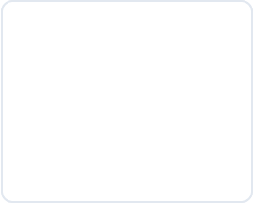
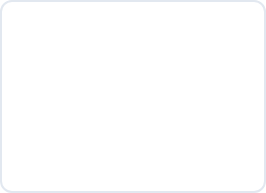






Slide 03
The AI Customization Ecosystem
Prompt Engineering
RAG
Fine-Tuning
Pre-Training
Fastest and cheapest. Modifies behavior via temporary text context without changing weights.
Retrieval-Augmented Generation. Injects external, live knowledge to reduce hallucinations.
Updates internal weights to change fundamental behavior, tone, and deep domain knowledge.
Creating a model from scratch. Costs millions of dollars and requires massive datasets.
Start with prompting. Move to RAG for facts. Move to Fine-Tuning for behavior.

Slide 4
Slide 04
Prompting vs. RAG vs. Fine-Tuning
Comparing the three primary enterprise approaches.
Feature | Prompt Engineering | RAG (Retrieval) | Fine-Tuning
Memory Type | Short-Term (Context Window) | Long-Term (Vector Database) | Internal (Neural Weights)
Implementation Cost | Very Low | Medium | High
Changes Model Weights? | No | No | Yes
Best Used For | Simple Instructions & Formatting | Live Facts & Corporate Docs | Brand Tone & Complex Tasks
Fine-tuning is for teaching a model a new skill, not for teaching it new facts.

Slide 5


Slide 05
When to use RAG vs Fine-Tuning
Choose RAG When...
Choose Fine-Tuning When...
•
Data changes frequently (e.g., live pricing or inventory).
•
You need a highly specific tone or output format (like strict JSON).
•
You need exact source citations for compliance.
•
RAG context window is too small or API calls are too expensive.
•
Hallucinations must be strictly minimized.
•
Teaching the model a complex new "skill" (e.g., drafting legal clauses).
•
You cannot afford to retrain a model weekly.
The most advanced enterprise systems use Fine-Tuning AND RAG simultaneously.

Slide 6
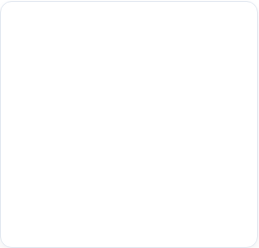
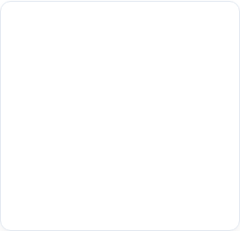
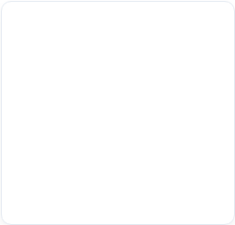





Slide 06
Primary Fine-Tuning Use Cases
Where weight updates provide the highest ROI.
Tone Matching
Format Adherence
Domain Jargon
Efficiency
Ingesting past emails to make a customer support bot sound exactly like your brand voice.
Training a model to strictly output complex SQL queries or JSON structures without conversational filler.
Teaching a model to understand dense Medical, Legal, or complex Engineering terminology inherently.
Distilling a massive model's capability into a smaller, cheaper model to run locally at the edge.
Fine-tuning excels at conditioning the "shape" and "style" of the output, rather than the informational content.

Slide 7

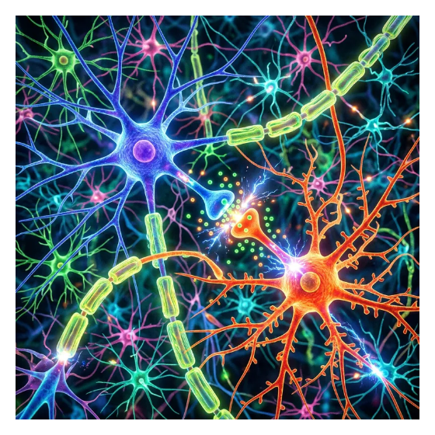
Slide 07
What is Full Fine-Tuning?
Full Fine-Tuning (FFT) recalculates every single weight in the neural network during backpropagation.
•
If a base model has 70 Billion parameters, FFT requires updating all 70 Billion weights.
•
This demands massive clusters of GPUs to hold the model, optimizer states, and gradients in memory simultaneously.
•
Produces an entirely new, massive model file.
Full Fine-Tuning is the traditional approach, but it is notoriously resource-intensive.

Slide 8
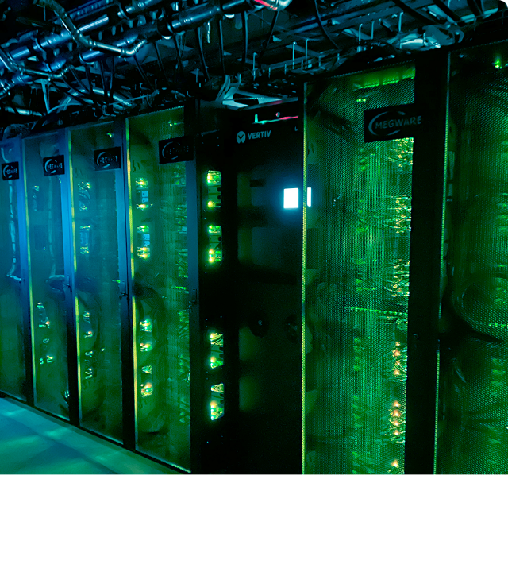

The Problem with Full Fine-Tuning
While effective, Full Fine-Tuning is financially prohibitive for most enterprises.
•
A 7B parameter model might require 8x A100 GPUs (costing $10k+ / month).
•
Training takes days or weeks of continuous compute.
•
Results in a massive new model file that must be hosted independently, multiplying MLOps overhead.

Slide 9
Slide 09
Parameter-Efficient Fine-Tuning (PEFT)
Democratizing model customization for the enterprise.
PEFT revolutionized the industry by making fine-tuning possible on consumer-grade hardware.

Slide 10
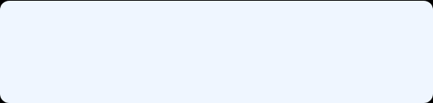




Slide 10
How PEFT Works
The ingenious logic behind Parameter-Efficient training.
Freeze Base Model
Inject Small Modules
Lock the billions of pre-trained weights so they cannot be changed, drastically saving GPU memory.
Add tiny, trainable layers (adapters) into the existing neural network architecture.
Train Only Modules
Merge for Inference
Backpropagate errors and update only the new, small layers, ignoring the massive frozen model.
Combine the tiny trained weights with the base model seamlessly for fast deployment.
PEFT achieves >95% of the performance of Full Fine-Tuning at <5% of the computational cost.

Slide 11

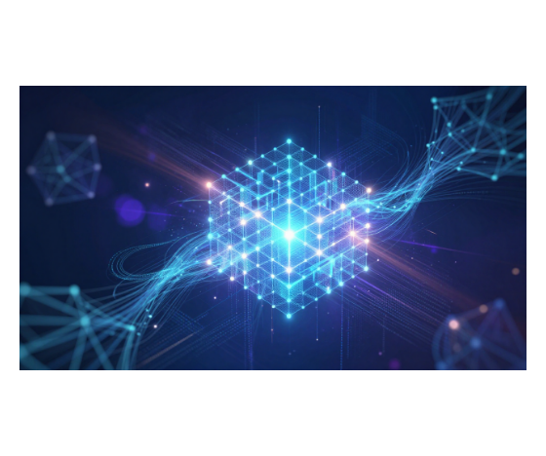
Slide 12
Introduction to LoRA
LoRA (Low-Rank Adaptation) represents weight updates using two smaller matrices rather than one massive matrix.
•
Instead of updating a massive 10,000 x 10,000 matrix, LoRA trains a 10,000 x 8 and an 8 x 10,000 matrix.
•
This mathematical trick reduces the number of trainable parameters by up to 99%.
•
The resulting "Adapter" file is tiny (often under 100MB).
LoRA relies on linear algebra to simulate massive neural updates using a fraction of the memory.

Slide 12
Slide 13
Full Fine-Tuning vs. LoRA
Full Fine-Tuning
LoRA (PEFT)
•
Trainable Params: 100%
•
Trainable Params: 0.1% - 1%
•
VRAM Requirement: Massive (Requires clustered A100s).
•
VRAM Requirement: Low (Can run on a single consumer RTX 4090).
•
Storage: 10GB to 100GB+ per model iteration.
•
Storage: 10MB - 100MB per adapter.
•
Deployment: Must host the entire massive model separately for every use case.
•
Deployment: Hot-swap tiny adapters onto a single hosted base model dynamically.
LoRA allows enterprises to host one base model and serve 50 different fine-tuned tasks instantly.

Slide 13


Slide 15
QLoRA: Quantized LoRA
Taking efficiency one step further to run on consumer hardware.
Quantization
Paged Optimizers
Reduces the base model precision from 16-bit to 4-bit, crushing the VRAM footprint.
Offloads sudden memory spikes during training to CPU RAM to prevent GPU Out-Of-Memory crashes.
LoRA Training
Democratization
Trains the small 16-bit LoRA adapters on top of the frozen 4-bit base model.
Allows fine-tuning a massive 65B parameter model on a single 48GB GPU.
QLoRA is the breakthrough that allowed researchers to fine-tune state-of-the-art models at home.

Slide 14
Slide 16
The Fine-Tuning Pipeline
The end-to-end MLOps process for customizing an LLM.
Data Curation
Formatting & Tokenization
Gathering high-quality instruction-response pairs specific to your enterprise domain.
Converting the raw data into strict JSONL format and processing it into model-readable tokens.
LoRA Training Loop
Evaluation & Deployment
Running the backpropagation loop using the HuggingFace Trainer API over several epochs.
Benchmarking against holdout datasets and deploying the base model + LoRA adapter.
Training is actually the easiest part; 80% of the work goes into Data Curation and Evaluation.

Slide 15

Slide 17
— Data-Centric AI Principle
In fine-tuning, data quality is vastly more important than data quantity. 1,000 perfect examples will beat 100,000 mediocre ones.
— Data-Centric AI Principle
LLMs are incredibly sensitive to dataset noise during the fine-tuning phase.

Slide 16
Slide 18
Data Quality > Data Quantity
The "LIMA" (Less Is More for Alignment) paper revolutionized how we view dataset sizes.
1
2
3
1,000 Curated Pairs
It proved that just 1,000 highly curated, perfectly formatted examples can effectively fine-tune a massive LLM.
Avoid GIGO
Garbage In, Garbage Out: Fine-tuning on messy, contradictory data permanently degrades reasoning capabilities.
Expert Curation
Dataset creation requires expensive domain experts, rather than cheap, low-quality crowd-workers.
Spend your budget on paying 5 experts to write perfect data, rather than scraping thousands of average internet posts.

Slide 17

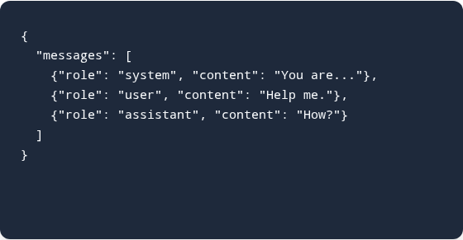

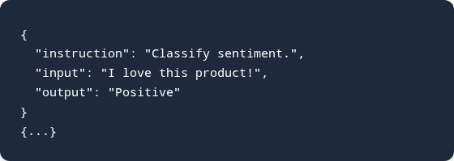

Slide 19
Formatting Instruction Datasets
Models must receive data in exactly the shape they were pre-trained on.
If you format the data incorrectly, the model will learn your bad formatting instead of the task.

Slide 18

Slide 20
Cost, Risk & Governance
Navigating the enterprise challenges of deploying custom models.
Technical feasibility is not the same as business viability; cost and risk dictate enterprise adoption.

Slide 19
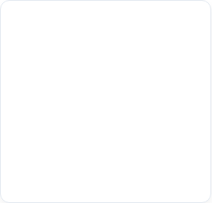
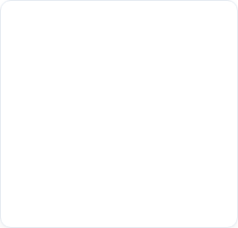
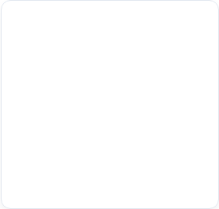
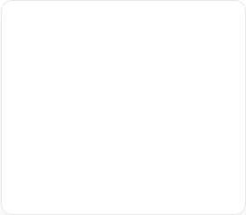




Slide 22
Hidden Costs of Fine-Tuning
Data Labeling
MLOps Infrastructure
GPU Hosting
Evaluation
Hiring expensive domain experts (lawyers, doctors) to write perfect "Gold Standard" responses.
Building complex pipelines for continuous integration, dataset versioning, and training.
Unlike API pay-per-token, you pay for the GPU 24/7 to keep the model loaded in VRAM.
Running expensive automated benchmarks and human A/B testing on every new model iteration.
The compute cost of training is often the cheapest part of the entire fine-tuning lifecycle.

Slide 20

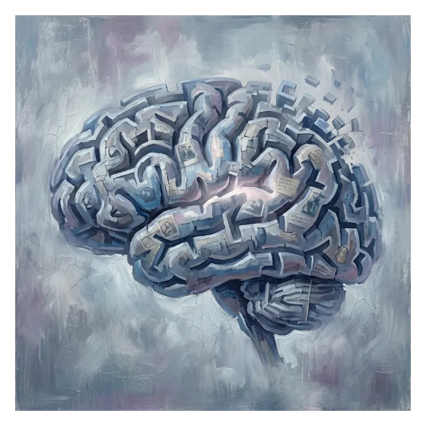
Slide 23
Risk: Catastrophic Forgetting
Catastrophic Forgetting occurs when a model learns a new task but completely overwrites its previously learned knowledge.
•
If you fine-tune an LLM strictly on medical coding, it might "forget" how to write generic Python or carry on a normal conversation.
•
Over-tuning makes the model highly specialized but destroys its general reasoning capabilities.
Specialization comes at a cost; you trade general intelligence for specific domain mastery.

Slide 21





Slide 24
Mitigating Catastrophic Forgetting
Low Learning Rates
Data Replay
Make tiny, slow mathematical adjustments so old foundational weights aren't drastically overwritten.
Mix 10-20% of general pre-training data (like Wikipedia) alongside your custom domain dataset.
Early Stopping
Use LoRA
Monitor validation loss and stop training before the model overfits completely to the new dataset.
PEFT naturally protects base weights by freezing them, significantly reducing the severity of forgetting.
A balanced dataset and PEFT architecture are the best defenses against model degradation.

Slide 22

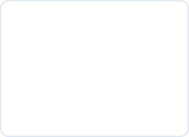






Slide 25
Model Evaluation Framework
Human Evaluation
Academic Benchmarks
Domain-Specific Tests
LLM-as-a-Judge
Blind A/B testing of model outputs. Still the gold standard for tone and nuance.
Running MMLU or HumanEval to ensure general knowledge hasn't dropped off.
Custom automated unit tests for your specific use case (e.g., JSON schema validation).
Using a massive model (like GPT-4) to systematically grade the fine-tuned model's responses.
You cannot manage what you cannot measure; rigorous evaluation pipelines are mandatory.

Slide 23
Slide 26
Performance vs Domain Complexity
Visualizing the impact of customization strategies.
30%
Base Model
Out-of-the-box performance using pre-trained general knowledge.
50%
Prompting
In-context learning and reasoning guided by system instructions.
75%
RAG
Factual grounding via external vector database integration.
95%
Fine-Tuned + RAG
Domain-adapted behavior combined with real-time enterprise facts.
The highest enterprise performance is achieved by combining Fine-Tuning (for behavior) and RAG (for facts).

Slide 24

Slide 27
Model Lineage & MLOps
Fine-tuned models must be versioned and tracked just like software code.
•
Traceability: Tracking which dataset version produced which LoRA adapter is critical for reproducibility.
•
Rollbacks: If a new model behaves erratically, you must be able to instantly swap to the previous adapter version.
•
Tools like MLflow, Weights & Biases, and HuggingFace Hub are mandatory for managing this lineage.
Without strict MLOps, a fine-tuned model becomes an untraceable, unmaintainable black box.

Slide 25




Slide 28
Governance & Compliance
Protecting the enterprise from fine-tuning liabilities.
Data Provenance
Bias Amplification
Red Teaming
Legal Alignment
Ensuring no copyrighted material or PII (Personally Identifiable Information) enters the training set.
Fine-tuning can accidentally amplify toxic traits or biases if the custom dataset is skewed.
Aggressively testing the fine-tuned model for security jailbreaks and prompt injections before launch.
Confirming output adheres to industry regulations (e.g., HIPAA in healthcare, FINRA in finance).
When you fine-tune a model, you take legal ownership of its generated outputs.

Slide 26
Slide 29
Enterprise AI Maturation Journey
Prompt Engineering
RAG Integration
Testing feasibility rapidly using generic foundation models via closed APIs (Low commitment).
Grounding the model in corporate knowledge and private databases to eliminate hallucination.
PEFT / LoRA
Small Language Models (SLMs)
Customizing open-source models' behavior and tone to perfectly match brand standards.
Deploying highly specialized, cheap, fine-tuned tiny models at the edge for maximum efficiency.
Do not skip steps. Attempting to fine-tune before mastering prompting usually leads to failure.

